Slide 1
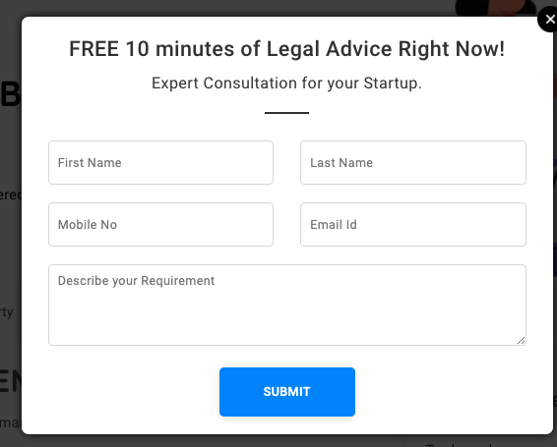
Have questions?
claim 10 min FREE talk time Worth INR 299* and
Consult a Lawyer now.
Talk now

Slide 2
Some important the Tag lines only for Just Consult
Real insights for your peace of mind!
Advice that matters!
End of your worries now!
Honest advice trusted support

Slide 3
Why LegalKart
24/7 access — reach out whenever you need
Eliminate commute time and scheduling hassles
Flexible plans to meet your needs and lifestyle
Seamlessly switch Lawyers, at no extra cost
Save money while receiving high-quality advice

Slide 4
We need this comparison on the JC page
Percentage of clients able to consult a Lawyer instantly
Thousands of client’s experience:
Legalkart vs. A reference Lawyer
100%
90%
Found Legalkart equally
Or better than discussing with a reference Lawyer
1%
98%
Found LegalKart convenient and affordable
Another website
LegalKart

